Slide 1

DatA and web mining
Application of data mining tools + Techniques CA
Dermot Madsen – 10522567
Ciaran Finnegan - 10524150
Wine Quality Dataset

Slide 2
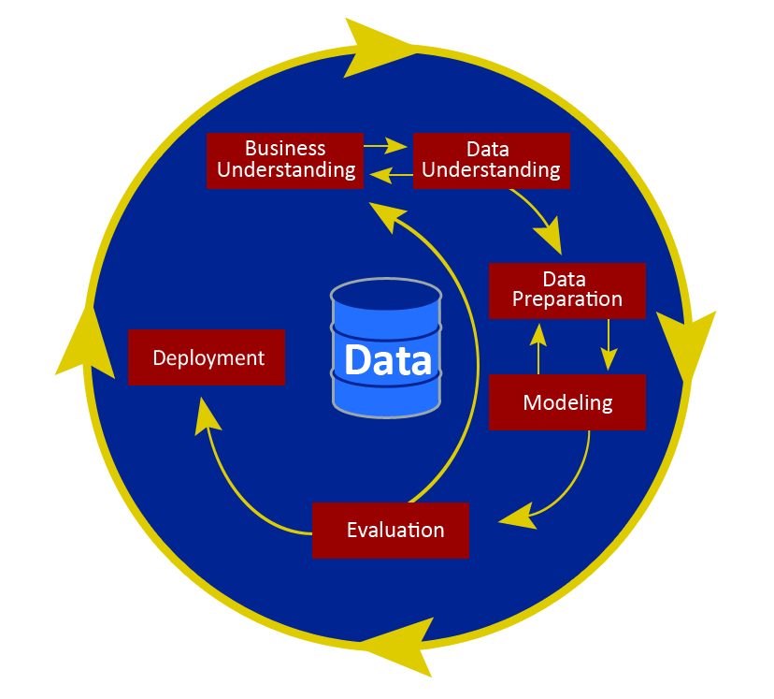
CRISP-DM

Slide 3
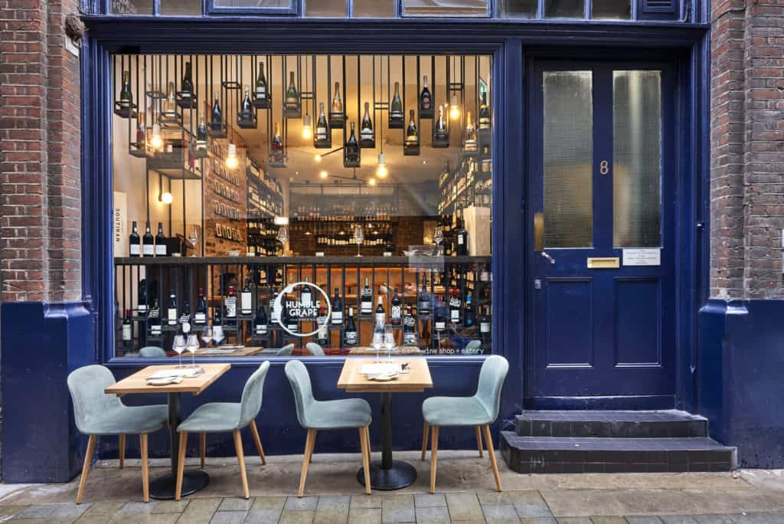
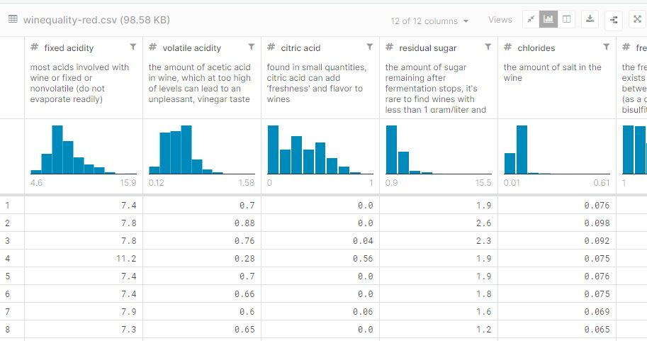

CRISP-DM : Business Understanding
Build a data driven predictive model to help staff recommend wine to customers.
Based on chemical data, not marketing or financial.

Slide 4
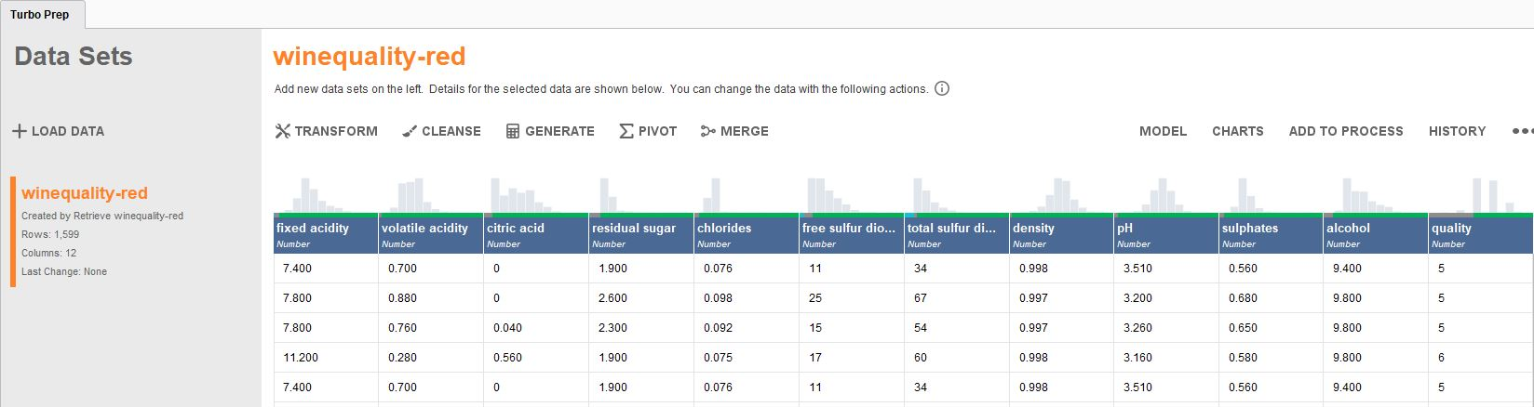
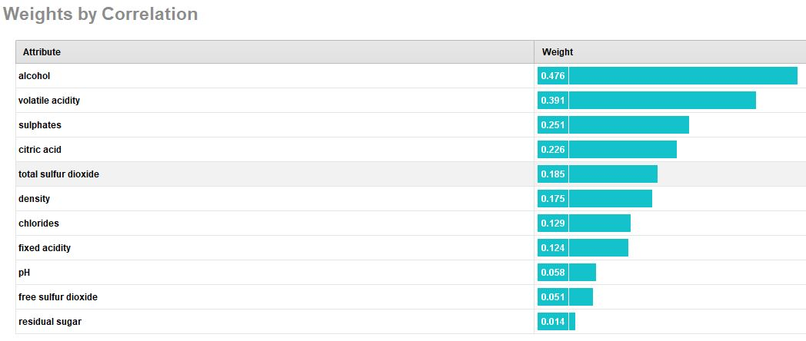
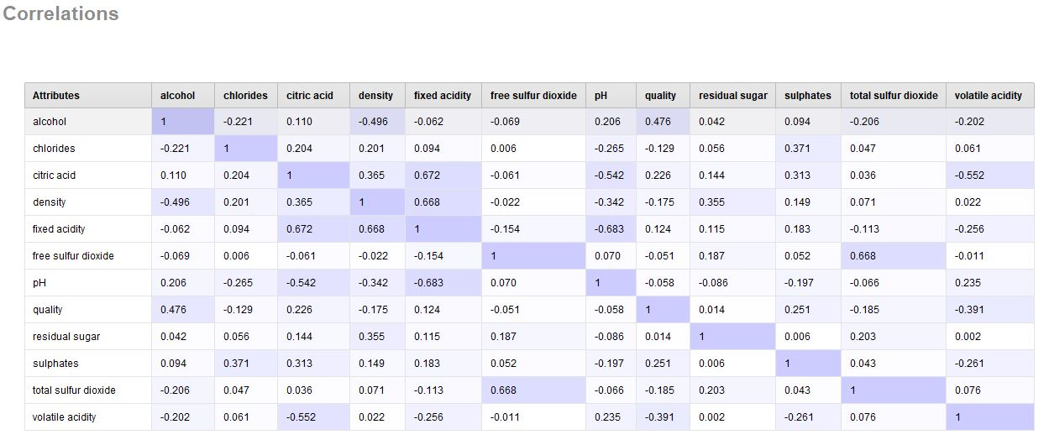
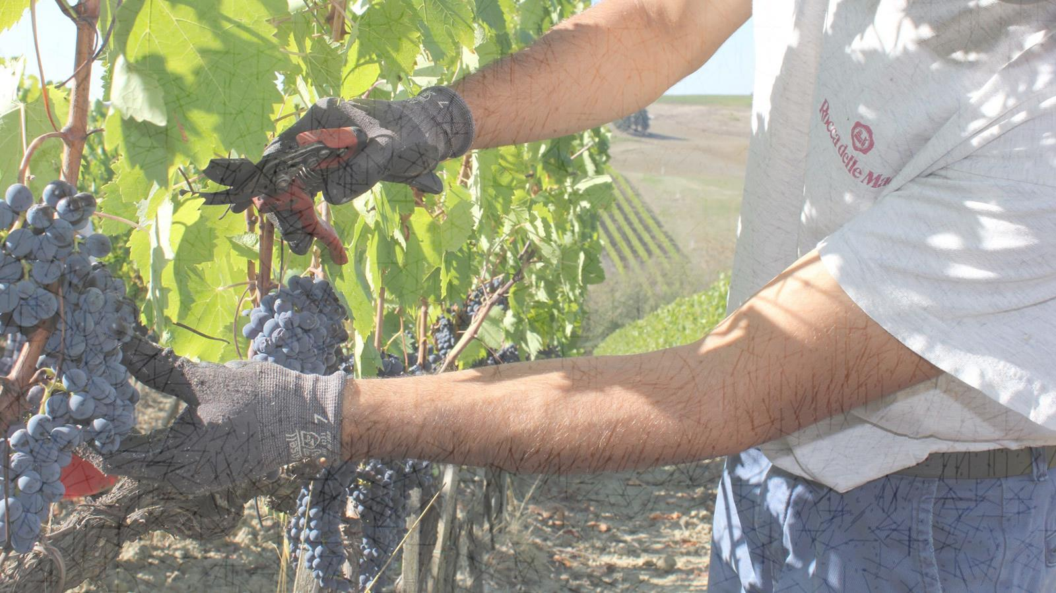
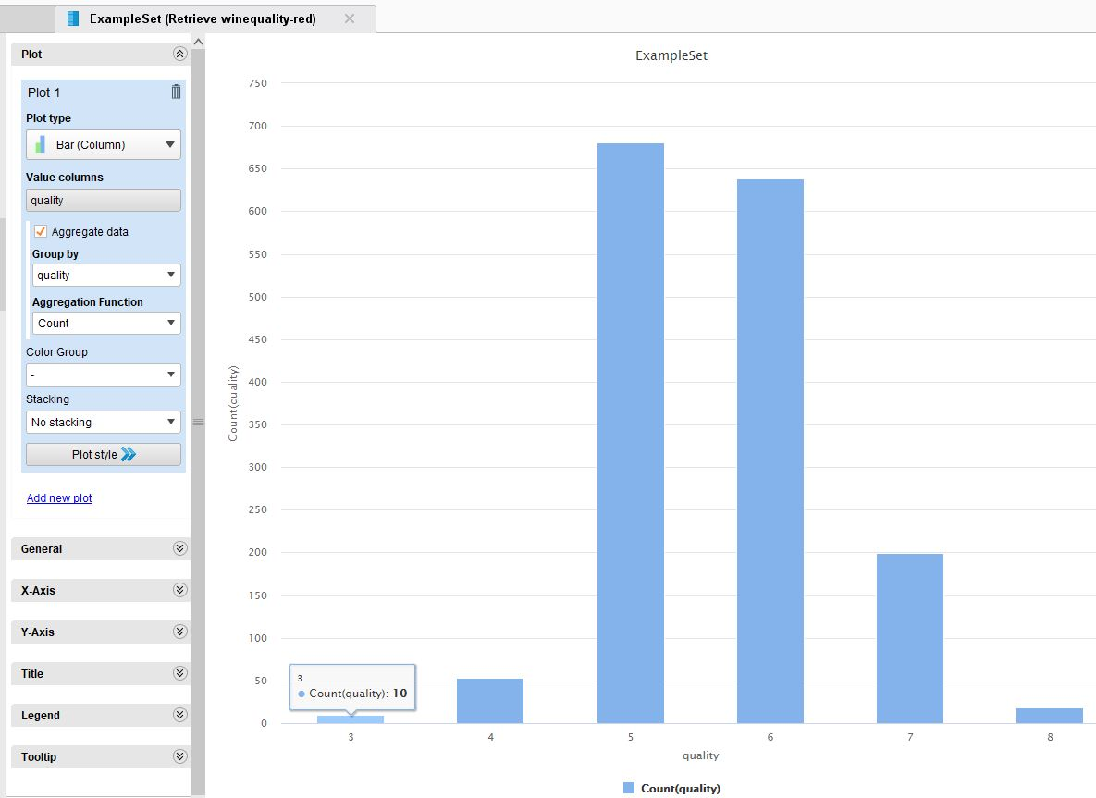
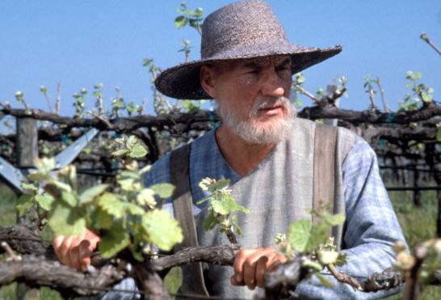
CRISP-DM : Data Understanding
Exploring the data – Kaggle Wine Quality dataset.
1600 rows x 12 columns.
‘Clean’ dataset – no missing rows, or ‘bad’ data.
Attributes vary in importance for ‘quality’.
Some correlation between features. Options to ‘prune’ feature list.
Dataset out of balance – few very poor or high quality wine entries.

Slide 5
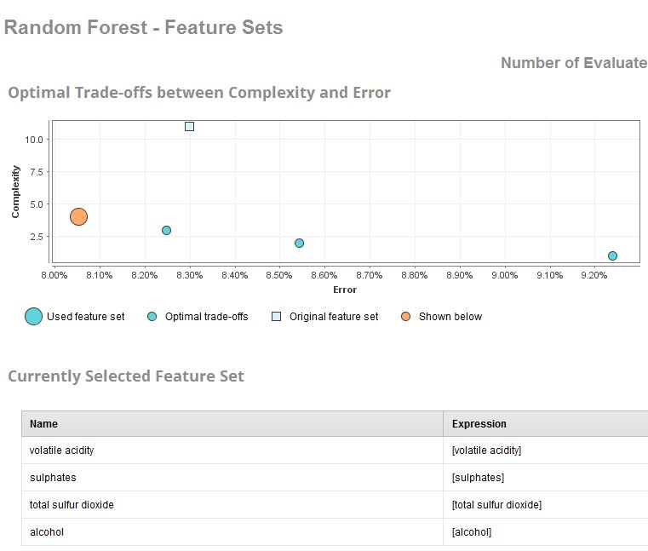
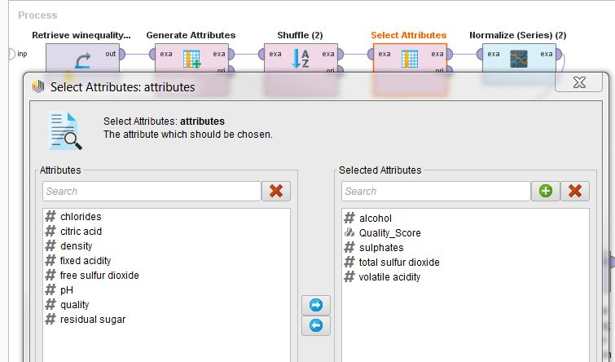

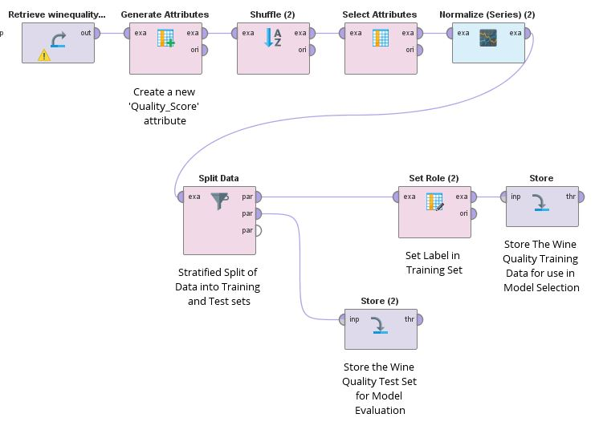

CRISP-DM : Data Preparation
All rows in the Wine Quality dataset were suitable for modelling.
RapidMiner AutoModel suggested a reduced feature set.
No ‘clean-up’ required.
Build a ‘Data Manipulation’ process in RapidMiner to also...
Create a new attribute to categorize the wine quality – Poor, Medium, High.
Shuffle the data.
Normalize the attribute values – to prevent bias with certain columns
Store the transformed Training and Test data

Slide 6

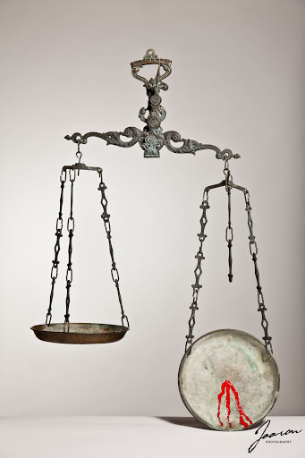
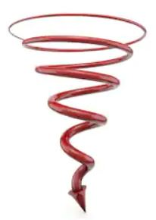
CRISP-DM : Data Preparation
The major challenge with the data was lack of balance across the wine quality categories.
Synthetic creation of new data
Options...
‘Down’ sampling of ‘real’ data
We used a combination of both.

Slide 7
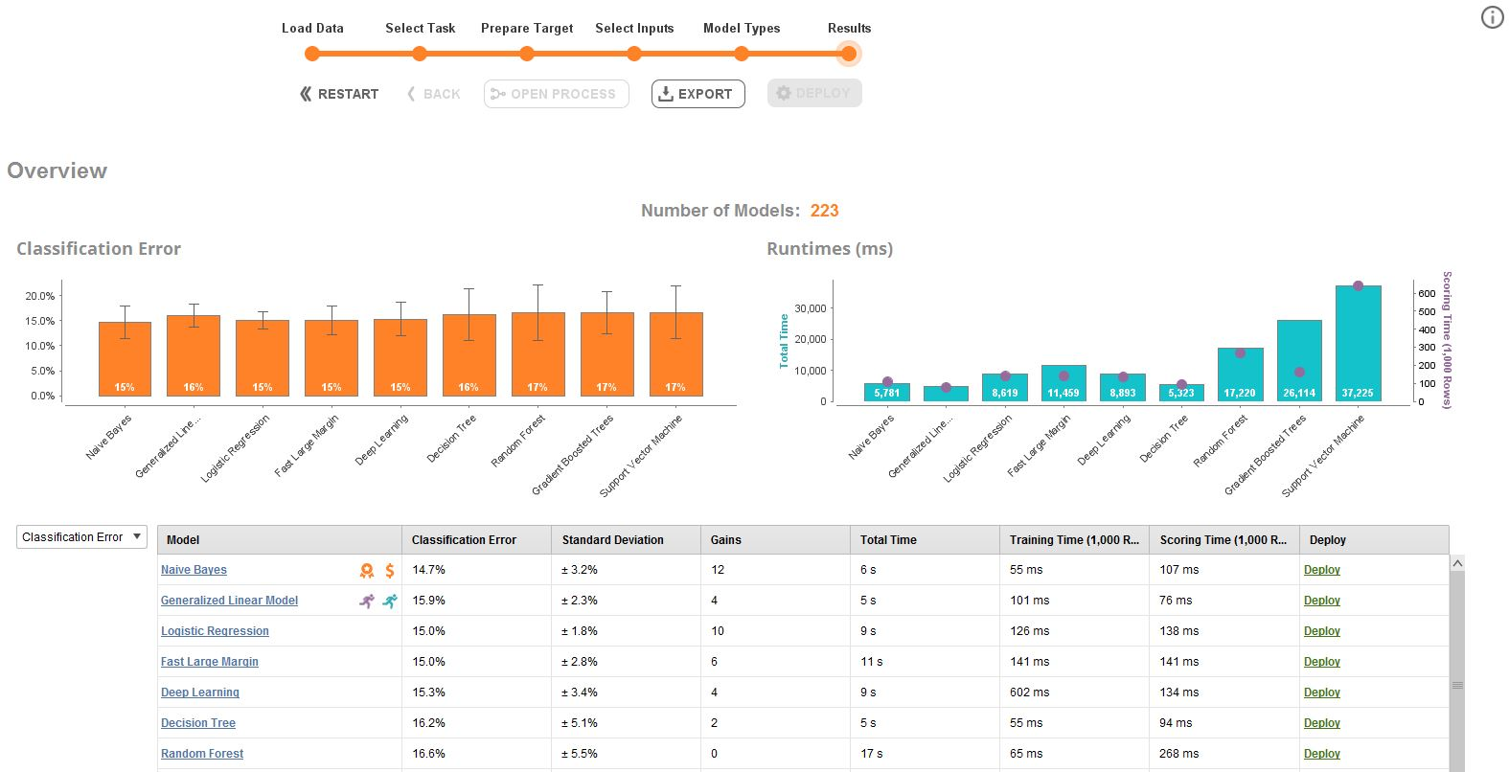
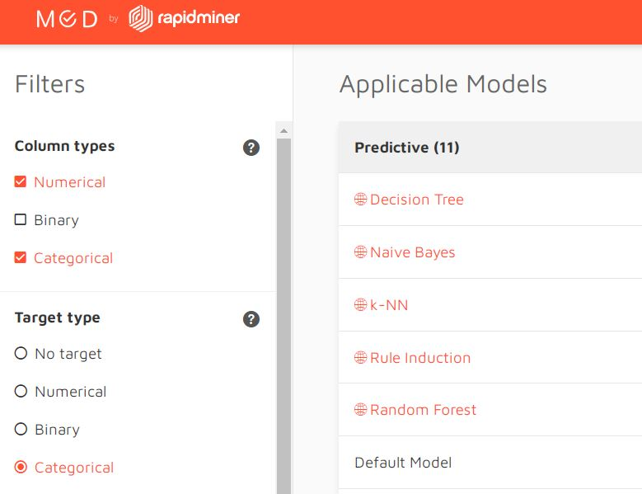
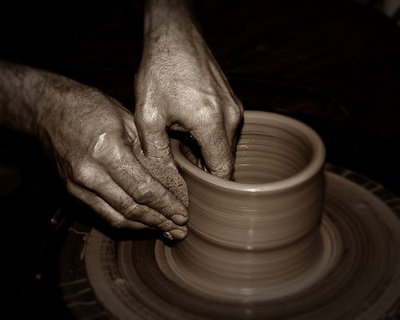
CRISP-DM : Modelling
Looked at RapidMiner AutoModel output but also at the RapidMiner utility for model selection.
Settled on 5 candidate algorithms...
Spent most time trying optimise model with Decision Trees, Random Forest and k-NN.

Slide 8
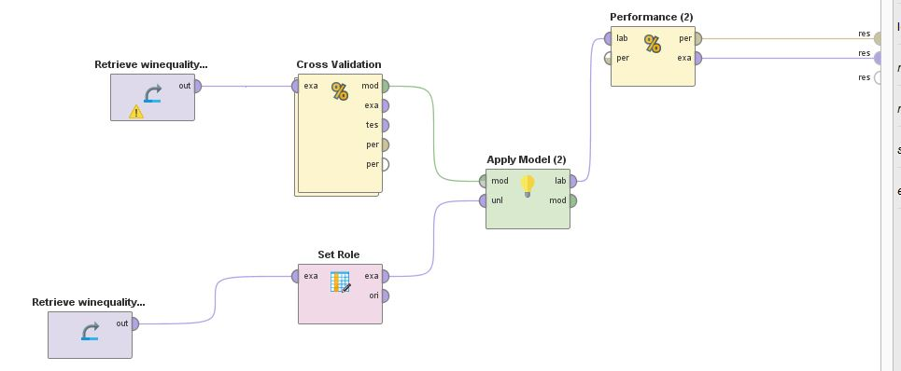
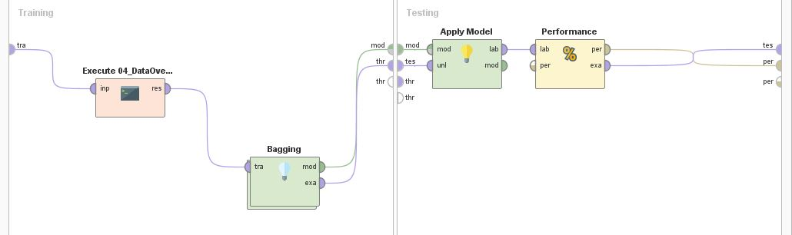

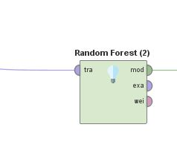
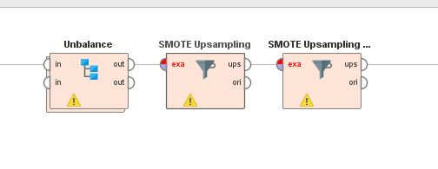
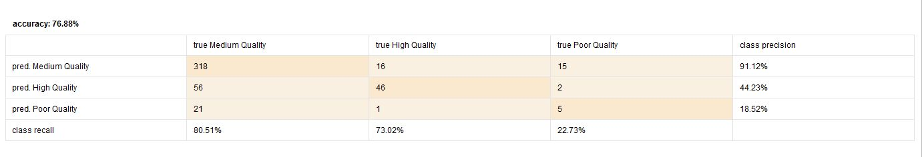
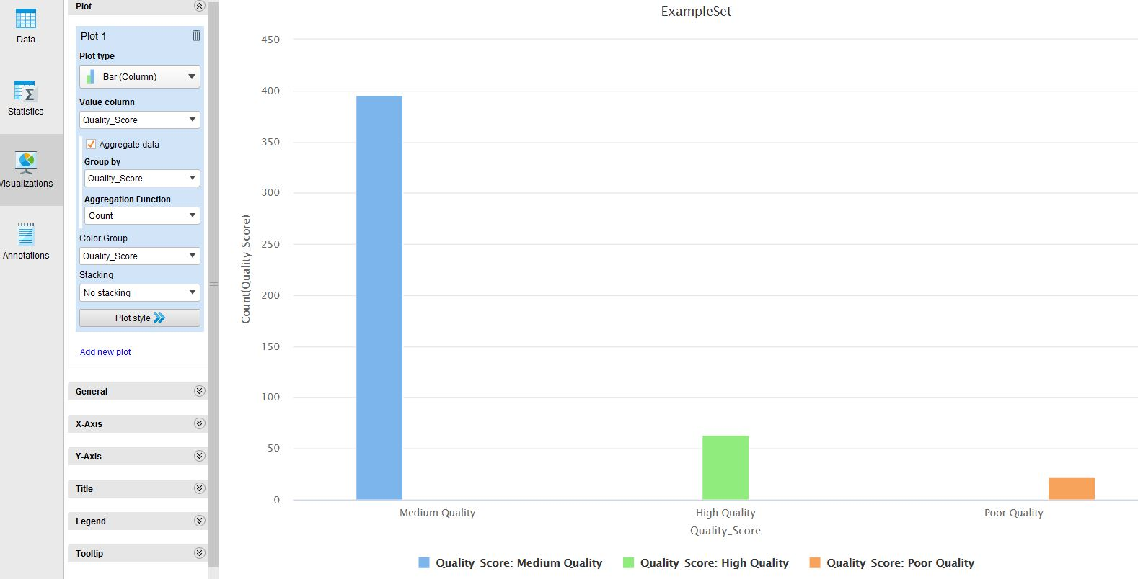
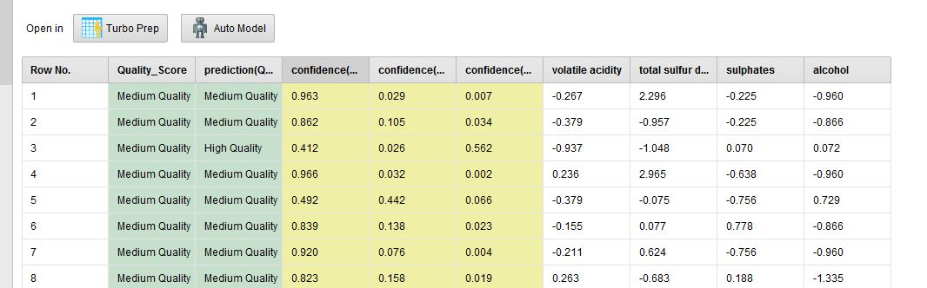
CRISP-DM : Modelling / Evaluation
Iterating through RM Processes and evaluating results.
Modelling
Evaluation

Slide 9
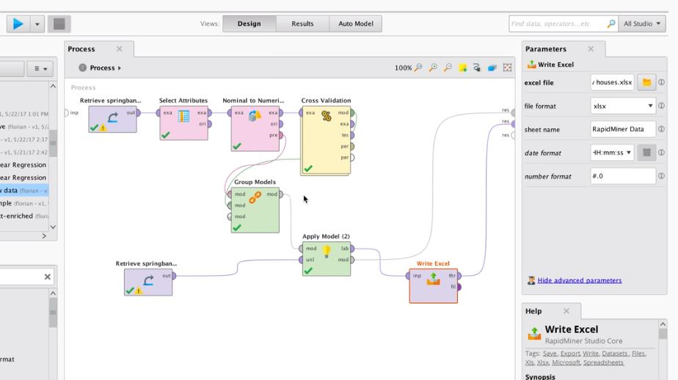
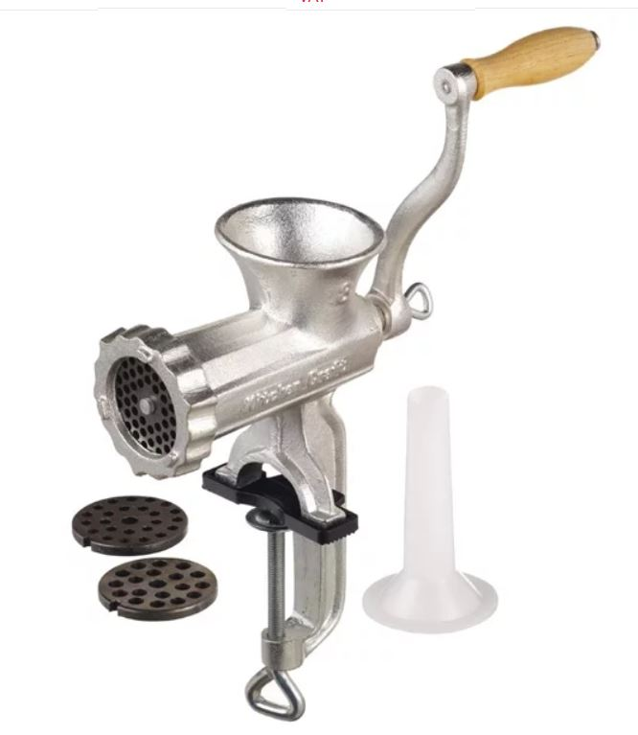
CRISP-DM : deployment
Read in new data to generate results in Excel ouput.

Slide 10



CA : Wine Quality Model : conclusion
The volume, balance, and nature of the data structure in the wine quality dataset made it difficult to build a useful model.
The business objective could be considered partially met in terms of acceptable accuracy with ‘Medium’ quality wines.
Perhaps a manual process could supplement the model for non-’Medium’ quality wines?

Slide 11
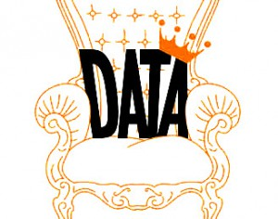
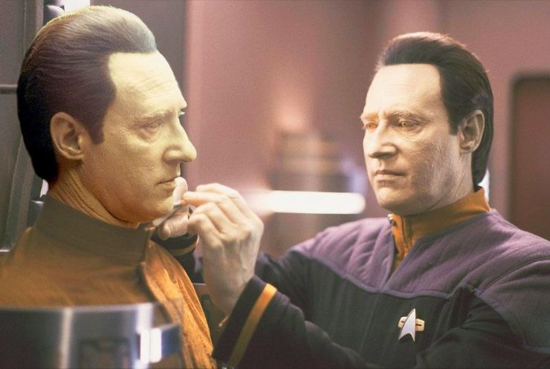
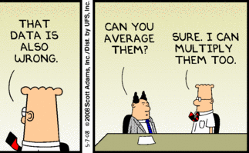
Learnings
The volume and quality of data is crucial.
Beware artificial data.
Models can be refined but cannot compensate for poor data.

Slide 12
